Slide 1
LZ77 Data Compression Algorithm
Berik Gulina
Abdikalyk Gulnazym

Slide 2

Outline
1-Basic definition
2-Short example
3-Working principle
4-Deeper example
5-Conclusion

Slide 3

LZ77
LZ77 was announced in 1977 and termed as the base of so many other lossless compression algorithms. Named in honor of its creators: Abraham Lempel (Abraham L empel) and Jacob Ziva (Jacob Z iv). It normally uses the method of “Sliding Window”.
Offset—It can be termed as the actual start of the phrase and the beginning of the file.
Run-length—It is defined as the quantity of the characters that help you in making a phrase.
Deviating characters—These are the marketers that indicate a new phrase.

Slide 4
The Main Method
LZ77 compression algorithm using the way of dictionary compression, is a simple but very efficient data compression algorithm.
The method is to add some characters in the data that can be organized into phrases into the dictionary, and then use tags to replace phrases in the dictionary when the same characters appear again. In this way, the compression is carried out by using tags to replace the most repeated occurrentions.

Slide 5
Example
Kazakhstan’s middle school Kazakhstan’s primary school.
We use a pair of pieces of information (the distance between the two, the length of the same content) to replace the latter piece of content.
Kazakhstan’s middle school (27,16) primary (20,6)

Slide 6
The Compression
When compressing data, there are two conditions between the forward buffer and the moving window after the phrase matching is done:
When no match is found: Encode a mismatched symbol as a symbol token (mostly the character itself)
When a match is found: Encodes its longest match as a phrase token.
The phrase tag contains three parts of information: the offset in the sliding window (calculated from where the match started), the number of symbols in the match, and the first symbol in the forward buffer after the match ends.

Slide 7
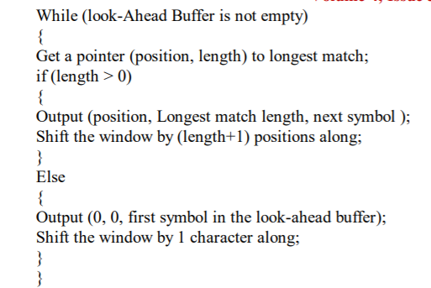
Woking Principle

Slide 8



The Compression
A B (2,2,C)

Slide 9



The Compression
A B (2,2,C) (4,3,A)
A B (2,2,C) (4,3,A) (6,2,A)
A B (2,2,C) (4,3,A) (6,2,A) D

Slide 10
Searching buffer area:
1. This part of the data packet has been compressed into the compressed file
2. A string corresponding to the data to be compressed will be found to duplicate in the field in the future
3. With the compression of the search buffer continues to increase
Advance buffer area:
1. Data to be compressed
2. Fetch a string from the field each time and look for a match in the lookup buffer
3. As the compression proceeds, the antecedent buffer is shrinking

Slide 11
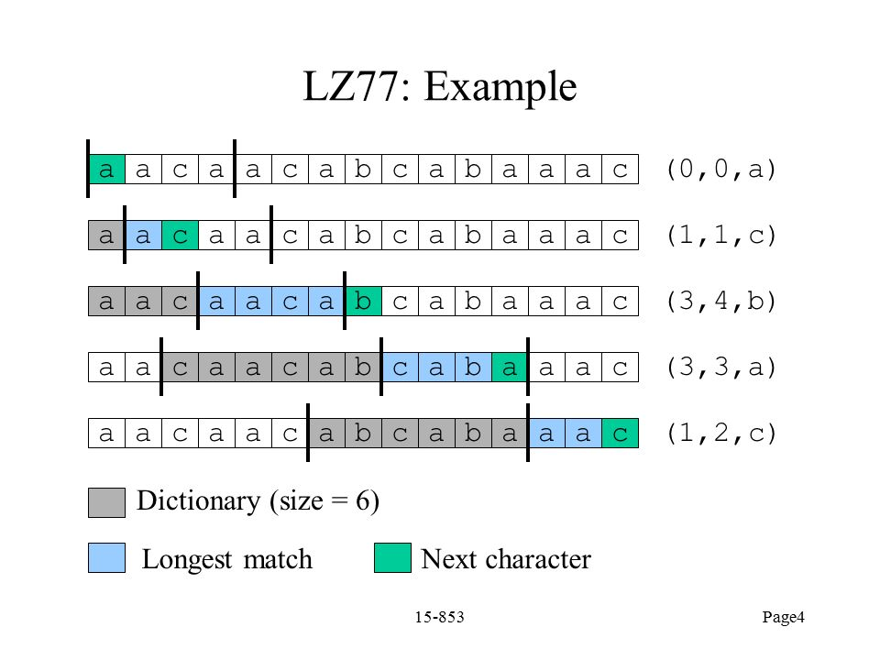

Slide 12
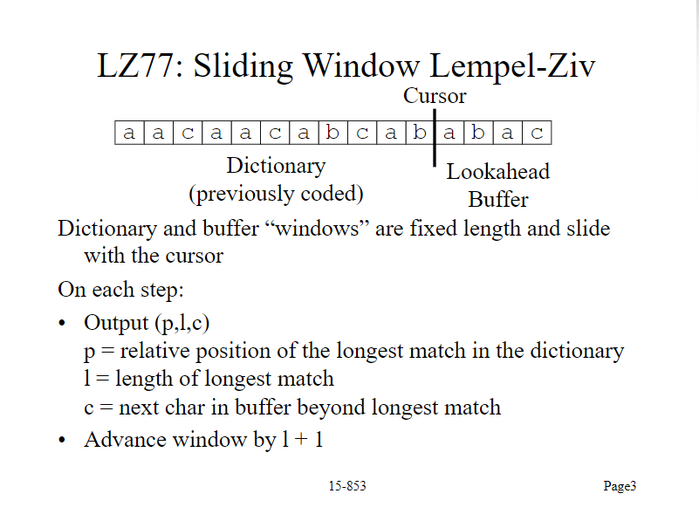

Slide 13

Thanks for paying attention!
Wish you have a nice day!

Slide 14
References
[1] Srivastava, V. (2020, October 31). 15 Most Popular Data Compression Algorithms. Retrieved from https://geekyhumans.com/most-popular-data-compression-algorithms/#Deflate
[2] Figure 2f from: Irimia R, Gottschling M (2016) Taxonomic revision of Rochefortia Sw. (Ehretiaceae, Boraginales). Biodiversity Data Journal 4: E7720. https://doi.org/10.3897/BDJ.4.e7720. (n.d.). doi:10.3897/bdj.4.e7720.figure2f

